Slide 1
ToDo
Fuzzing Rust Programs
How to fuzz Rust programs?
Let’s fuzz programs!

Slide 2
How to fuzz Rust programs?
Selecting a fuzzer
Collecting target Rust programs
Writing a fuzzing harness

Slide 3
Selecting a Fuzzer
Candidate open-source fuzzers for Rust
cargo-fuzz based on libfuzzer
afl.rs based on AFL++
Other candidates (not yet checked)
honggfuzz-rs based on honggfuzz
Binary only fuzzers (AFL++ QEMU mode)
Both use shared memory test cases and persistent mode, and do not support file input.

Slide 4

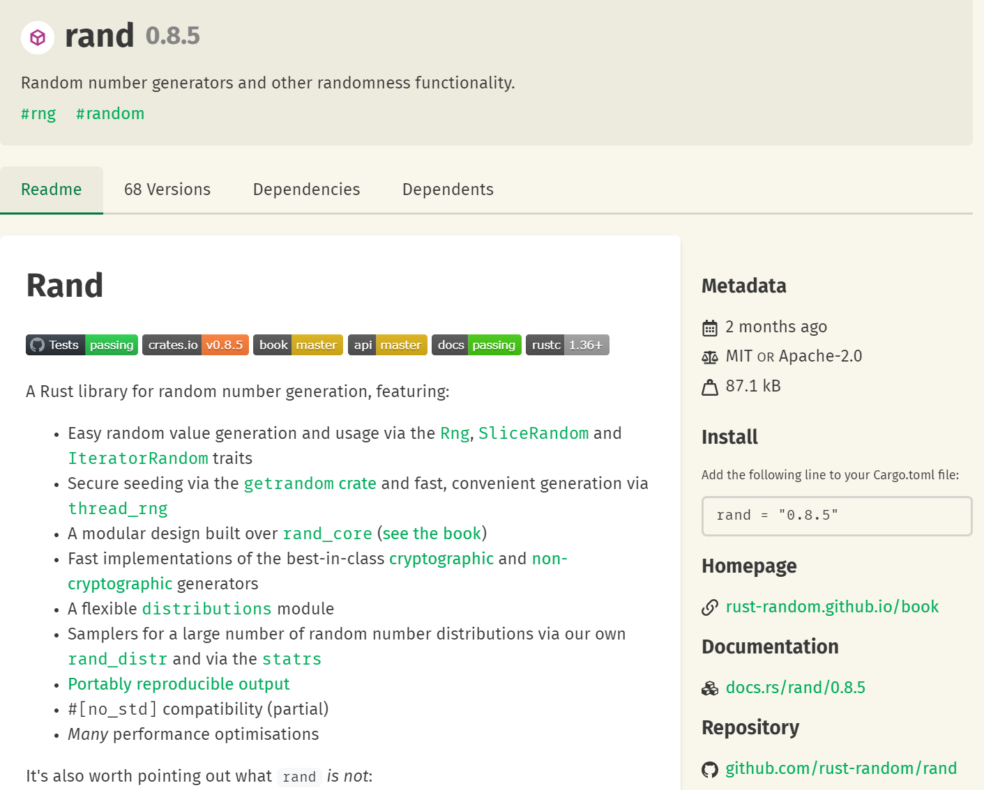
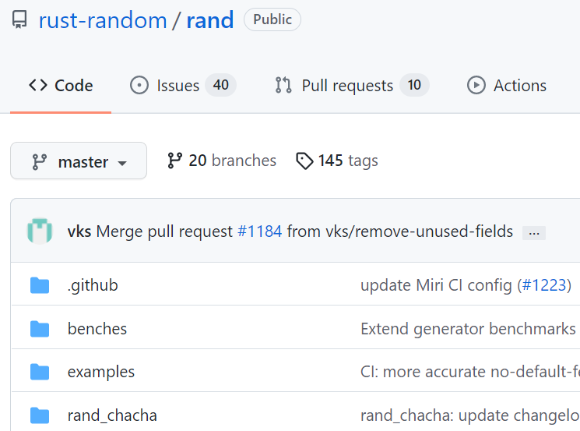
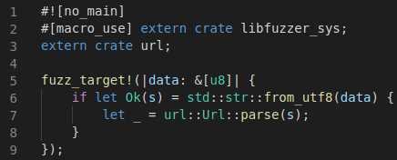
Collecting Target Rust Programs
From crates.io
more than 80,000 crates
With source codes
collectable from repository of each crate
Or just use libraries without source codes
just import a target library in my fuzzing target

Slide 5
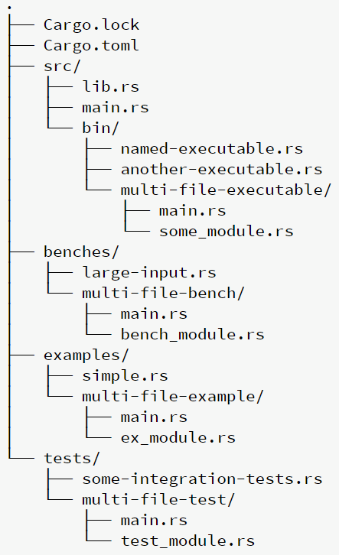
Collecting Target Rust Programs (Cont.)
Some binaries are also available
If a repository provide main.rs or other main entries in “bin” directory
Default library file “src/lib.rs”
Default executable file “src/main.rs”
Other executable files in “src/bin/”
Package layout convention of a crate

Slide 6
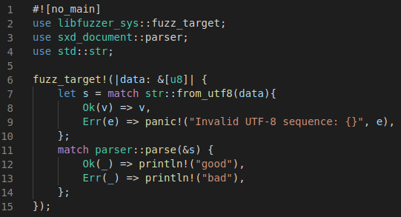
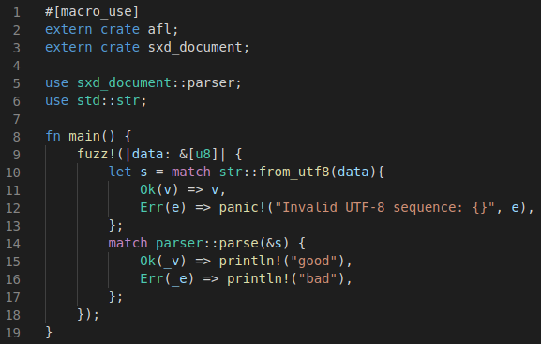
Writing a Fuzzing Harness (Fuzzing Target)
For cargo-fuzz
For afl.rs
input
Entry of fuzzing
Write an appropriate preliminaries and target library function call
Actual target library to fuzz
Identify fuzzing loop in the main function
input
Actual target library to fuzz

Slide 7
Let’s Fuzz Programs!
Selected fuzzers and target programs
Fuzzing setup and results

Slide 8
Selected Fuzzers and Target Programs
Two fuzzers cargo-fuzz and afl.rs
Target programs
sxd-document
xml parsing library for Rust
Having a safety bug previously found by cargo-fuzz
rust-url
Implementation of URL standard for Rust
Most recent version from crates.io
To check whether fuzzers can detect the known bugs or not
To check whether the bugs are safety bugs or not and whether RUDRA can find them or not
To check whether the fuzzers can detect a bug in a recent library

Slide 9
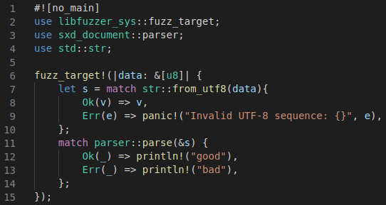
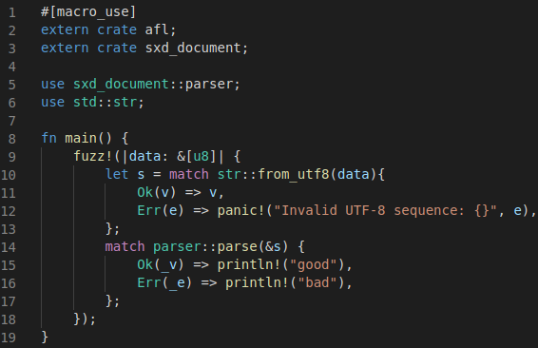
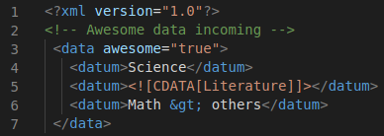
Fuzzing Setup for sxd-document
Fuzzing harnesses
A seed input xml file
Convert input bytes to a String
Target the function “parse”
Harness for cargo-fuzz
Harness for afl.rs

Slide 10
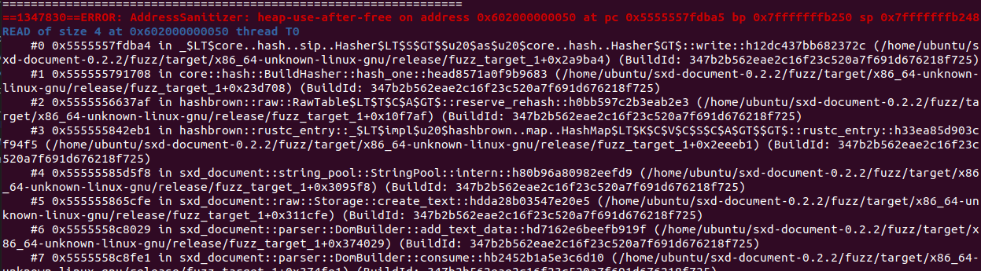
Results for sxd-document
Both cargo-fuzz and afl.rs found a crash.
cargo-fuzz found a crash with the seed input and terminates.
afl.rs found a crash within 3 min
not yet reproduced
AddressSanitizer is default for cargo-fuzz
Same as the known bug previously found by cargo-fuzz
use-after-free bug found by cargo-fuzz with AddressSanitizer

Slide 11
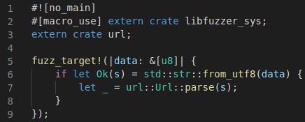
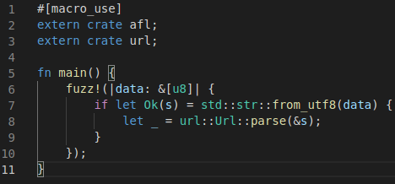
Fuzzing Setup for rust-url
Fuzzing harnesses
Three seed input strings
"tcp://example.com/"
"ssh://192.168.1.1"
"http://www.example.com:80/foo?hi=bar"
Convert input bytes to a String
Target the function “parse”
Harness for cargo-fuzz
Harness for afl.rs

Slide 12
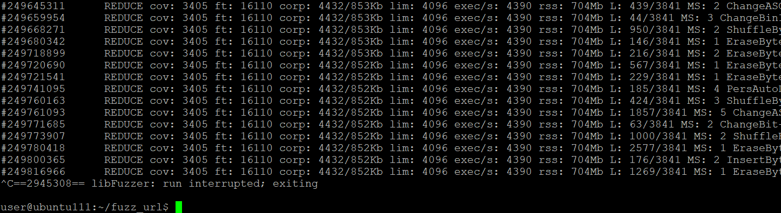
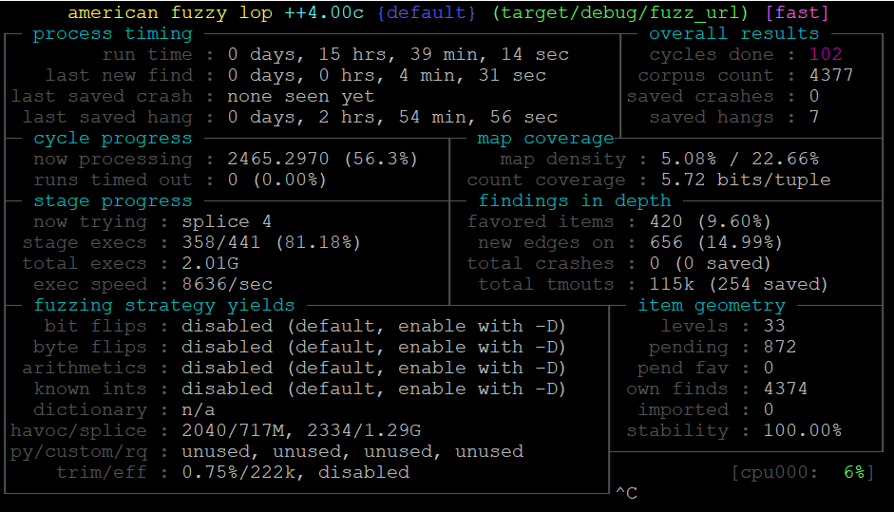
Results for rust-url
No crashes found by both cargo-fuzz and afl.rs within 15 hours

Slide 13
ToDo
Fuzzing Rust Programs
Check whether fuzzers can find memory safety bugs in Most Download crates
Does fuzzers detects memory safety bugs that RUDRA cannot detect?
Compare bugs that fuzzers found and RUDRA found
Analyze RUDRA algorithm to find bugs that RUDRA cannot find

Slide 15
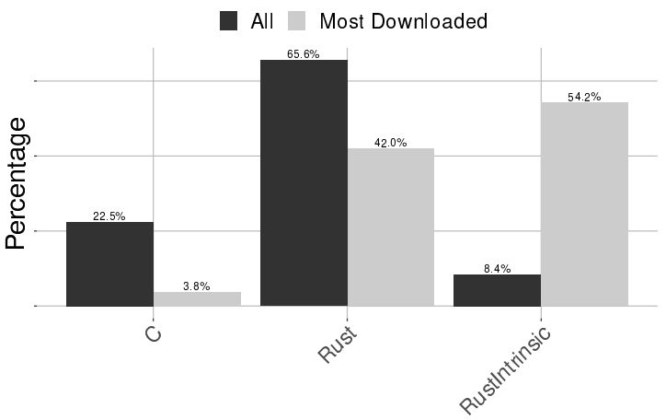
Supplement Last Week: What type of unsafe functions are called?
Three types of unsafe functions
extern C functions, declared Rust functions, and Rust Intrinsic
Contains many I/O memory access and atomic operations such as core::ptr

Slide 16
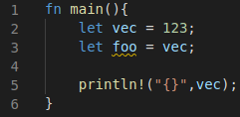
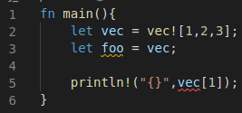

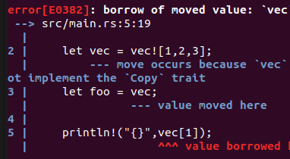

Preliminary: Ownership
An assignment copies the rhs value if the rhs is a “Copy”
e.g., i32
Otherwise (not a “Copy”), move the ownership to the lhs
e.g., Vec
The Copy trait definition
A program with an assignment of i32 (a Copy) rhs and its output
A program with an assignment of Vec<i32> (not a Copy) rhs and its output (compile error)

Slide 17
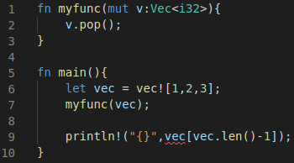
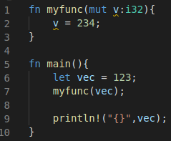
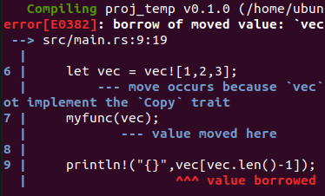
Preliminary: Ownership
Function call copies a parameter value if the parameter is a “Copy”
e.g., i32
Otherwise (not a “Copy”), move the ownership to the callee function
e.g., Vec
A program of a function call with an i32 (Copy) parameter and its output
A program of a function call with an Vec<i32> (not a Copy) parameter and its output (compile error)

Slide 18
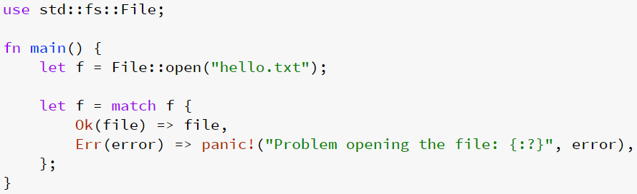
Preliminary: Tiered Error Handling
If something might reasonably be absent, Option is used.
If something goes wrong and can reasonably be handled, Result is used.
If something goes wrong and cannot reasonably be handled, the thread panics.
e.g., unwrap a None, index out of bounds, divide by 0, or user-defined panics
If something catastrophic happens, the program aborts.
f is a Result, not a file descriptor

Slide 19
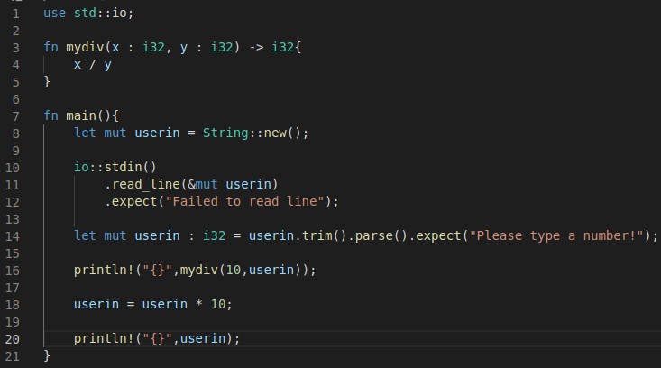
Preliminary: Unwinding
Unwinding current active call stack to call destructors when a panic occur
Immediately return mydiv (with destructor calls for x and y) at this line if div-by-zero panic occur
Immediately return main (with destructor calls for userin) at this line if div-by-zero panic occur

Slide 20
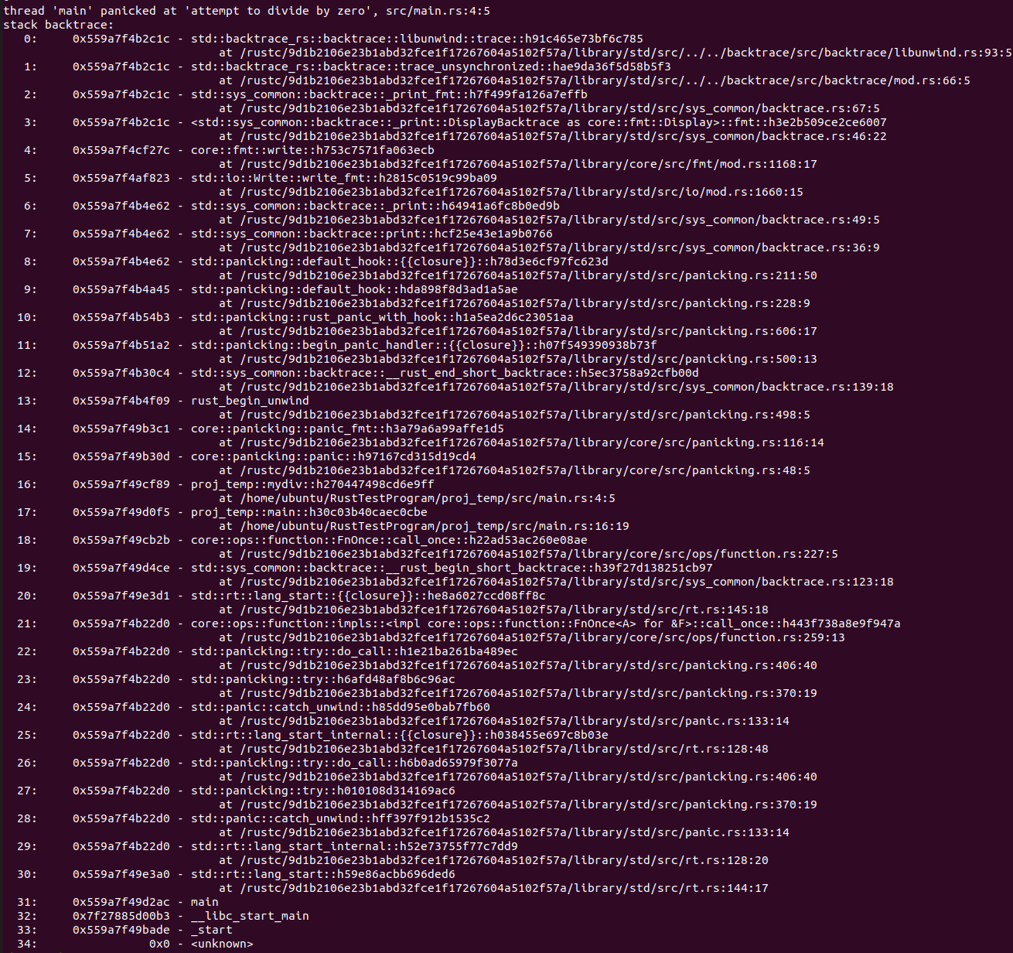

Slide 21
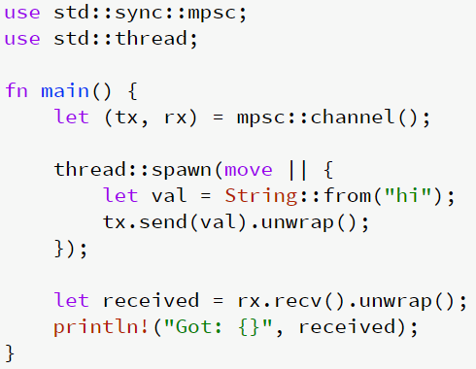
Preliminary: Send and Sync
A type is Send if it is safe to send it to another thread.
A type is Sync if it is safe to share between threads (T is Sync if and only if &T is Send).
String is a Send
Spawn a thread
Move ownership of the string to another thread
Receive the string and own the string value

Slide 22
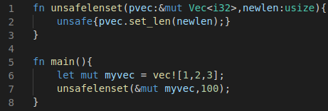
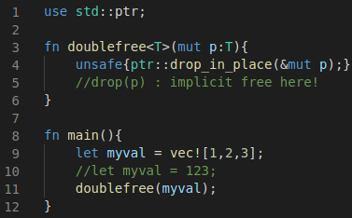

Defining Memory Safety Bugs in Rust (1/2)
A function $F$ has a memory safety bug if a call $F(v)$ where $v$ is a safe value can generate an unsafe state or return value.
e.g.,
A generic function has a memory safety bug if it can be instantiated to a function that has a memory safety bug.
e.g.,
set the length of a given vector as the given value
valid (types of) inputs for the function
invalid length of the vector, which is an unsafe state, after the function call
unsafe C style free
Double free in the function doublefree if myval is Vec<>
No double free in the function doublefree if myval is i32
(drop a primitive type do nothing)

Slide 23
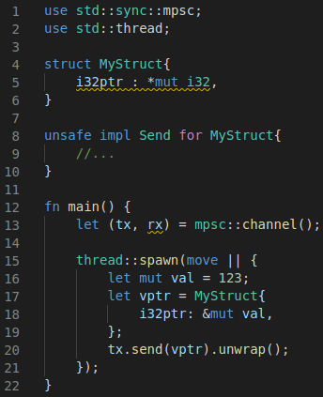
Defining Memory Safety Bugs in Rust (2/2)
A Send implementation has a memory safety bug if it is implemented on a type whose ownership cannot be transferred to another thread.
A Sync implementation has a memory safety bug if it is implemented on a type that defines a non-thread-safe method.
A type contains a raw pointer of which its ownership cannot be transferred.
Unsafe implementation of a type not Send makes the type transferrable

Slide 24
Three Mem Safety Bug Patterns
Panic safety bug
Higher-order safety invariant bug
Propagating Send/Sync in generic types bug
Which are hard to reasoning by traditional testing due to
Compiler generated codes (i.e., panic safety bug)
Limitation of Rust type system (i.e., higher-order safety invariant bug)
Manual trait implementation (i.e., propagating Send/Sync in generic types bug)

Slide 25
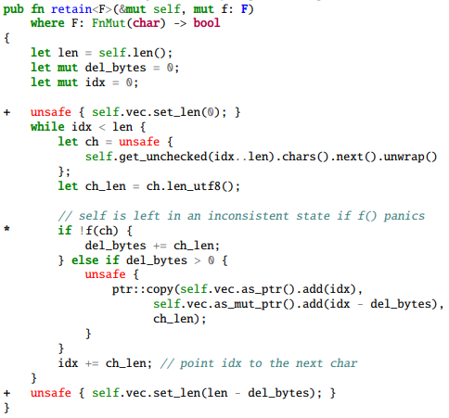
Panic Safety Bug
A function has a panic safety bug if it generates an unsafe state (temporarily) and can panic while retain the unsafe state.
Retain only characters that satisfy the given function f in a String (self)
Check for each character in the String
The function std::String::retain

Slide 26
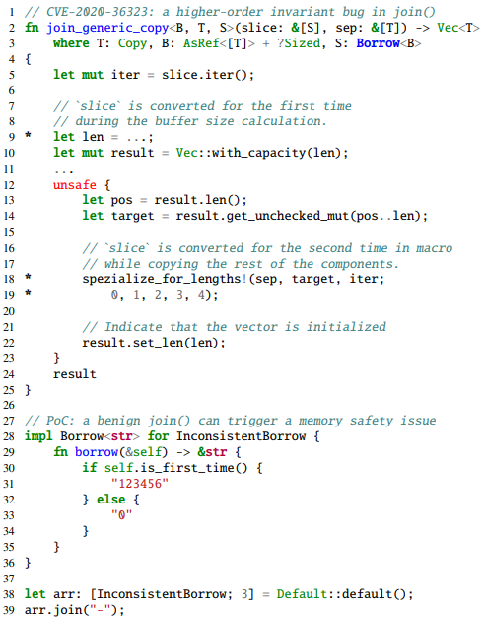
Higher-order Safety Invariant Bug
A higher-order invariant bug is a memory safety bug in a generic function that is caused by incorrectly assuming a higher-order invariant that is not guaranteed by the type system.
Borrow<B>s to join
Separator btw Borrow<B>s
Calculate the final length of the Vec to return using slice and sep
Join here!
Is the length of the result always same as the len after the join?
A generic function in join() for Borrow<str>

Slide 27
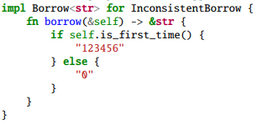
Higher-order Safety Invariant Bug
A higher-order invariant bug is a memory safety bug in a generic function that is caused by incorrectly assuming a higher-order invariant that is not guaranteed by the type system.
Borrow<B>s to join
Separator btw Borrow<B>s
Calculate the final length of the Vec to return using slice and sep
Join here!
Is the length of the result always same as the len after the join?
(e.g., an inconsistent instantiation of the generic type)
A generic function in join() for Borrow<>
Return value at the length calc time
Return value at the join time

Slide 28
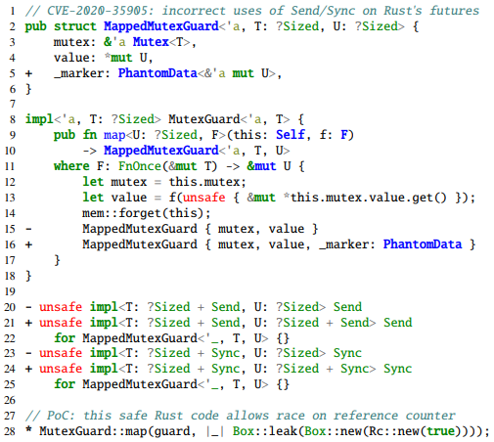
Propagating Send/Sync in Generic Types Bug
A generic type that takes a type parameter T has a Send/Sync variance (SV) bug if it specifies an incorrect bound on the inner type T when implementing Send/Sync.
The generic type U, which is a member of the MappedMutexGuard struct, is not guaranteed as Send
An incorrect Sync/Send implementation in futures library

Slide 29
Next ToDo
Fuzzing Rust Programs
with sanitizers

